Slide 1
Lesson 9: Phylogenetic regression

Slide 2
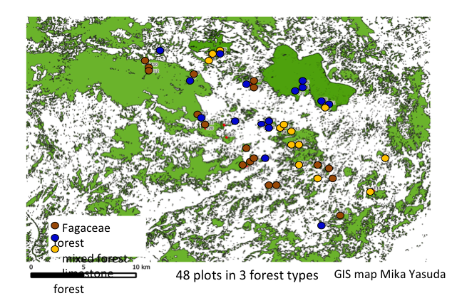
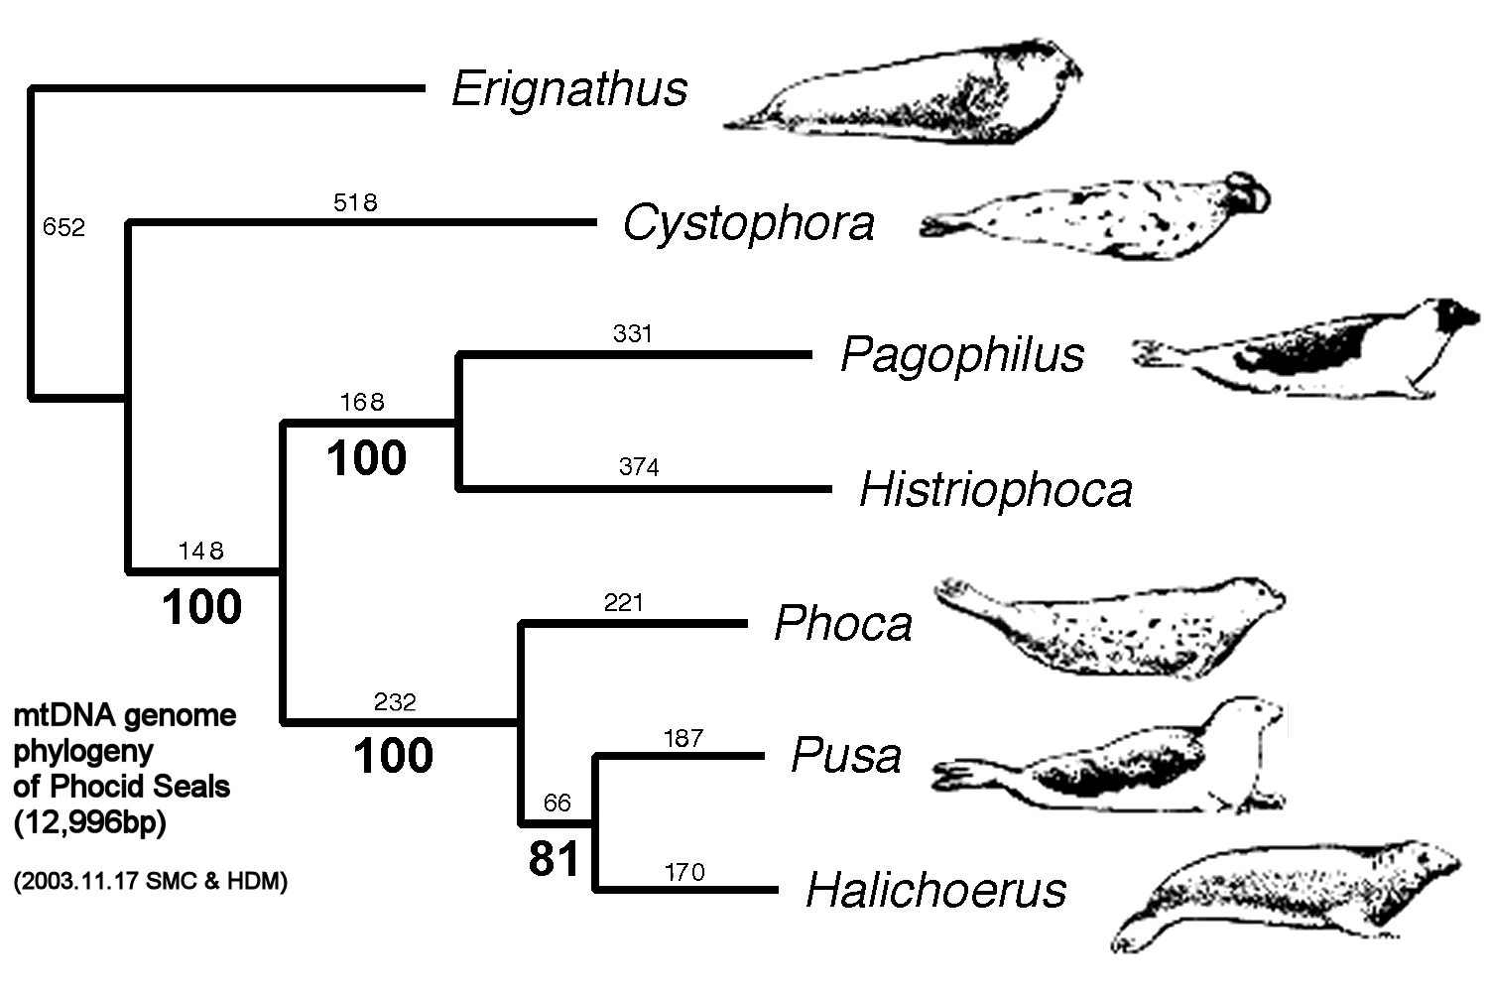
Dealing with auto-correlation
Data points that are close together in space, time or phylogeny are not independent.

Slide 3
IID Independently Identically Distributed
Statistical models assume that generated errors, ε, are IID.
We assume that all errors are sampled from the same distribution (identically distributed)
We assume that that they are independent of one another (If we know ε_{k} we cannot predict ε_{k+3})
In general, it is hard to get errors fully IID, but we try to do so.

Slide 4
Getting to IID
In order to get errors close to IID, we try to include information into our model of response Y that account for sources of covariance among y_{i}
e.g. in lmm, we included random blocking effects to account for grouped data pts
(pts from the same group may be more covariant with one another than pts outside the group)
e.g. in gls, we include information about distance between points (pts closer in distance may be more covariant than pts further apart)

Slide 5
Covariance in phylogenies
Covariance in phylogenies is fairly intuitive
-> based on shared evolutionary history
-> measured using common branch length in phylogeny
-> always relative, being based on the phylogeny provided
Species that diverged recently have longer common evolutionary history and hence high covariance
Species that diverged a long time ago have shorter common evolutionary history and low covariance
Shared path length = measure of covariance

Slide 6
Phylogenies & The Comparative Method
Many of us are involved in trying to understand variation among species (morphology, physiology, functional traits, niche space), by relating differences between them to environmental drivers. This is known as the Comparative method.
It is intuitive that two closely related species could share much greater variation because of their common evolutionary history than distantly related species.
When trying to understand variation differences between species in response to present-day environmental pressure, it is essential that we account for this shared evolutionary history.

Slide 7
Code 9.1 Evolution in a phylogeny

Slide 8
Evolution or environment? Phylogenetic regression
Phylogenetic regression allows us to incorporate both sources of variation, treating the evolutionary history as random variation and concentrating on the environment components as fixed effects.

Slide 9
The linear model with error covariance
Recall that: y = Xβ + ε where ε ~ N(0, V)
Where V = Cov[ε| X], the covariance matrix of errors. Ideally all off-diagonal elements of V are zero (i.e. no covariance)
✔

Slide 10
The linear model with error covariance
In reality ε ~ N(0, V) , where off-diagonal elements are non-zero. How large this off-diagonal component is affects how reliable our model inferences are.
✗
We use phylogeny to reduce covariance between error points.

Slide 11
Code 9.2 Turning a phylogeny into a covariance matrix

Slide 12
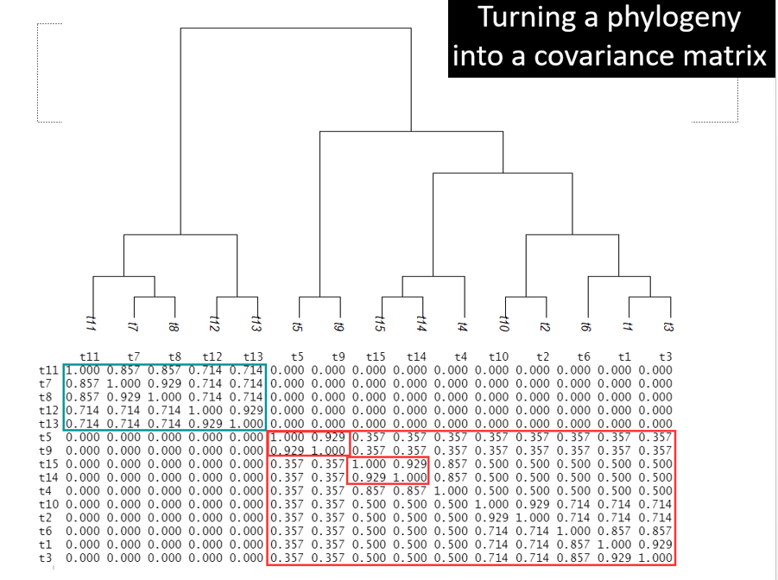

Slide 13
Modifying phylogenetic signal
OK, so we can model evolutionary covariance between tips (species), but the nature of covariance could change over history…
Strong co-evolutionary signal Weak co-evolutionary signal

Slide 14
Code 9.3 Modifying phylogenetic signal

Slide 15
The gls() function for phylogenetic regression
y = Xβ + ε
mod <- gls(y~x, data=dat,
correlation=corBrownian(phy= tree.primates))
gls() is set up in the ape package to model a covariance matrix that represents the shared evolution between species across the tree, as apparent in the phylogeny
We can either simply provide the phylogeny OR we can provide the covariance matrix
correlation=corSymm(TreeCovar1[lower.tri(TreeCovar1)] , fixed=TRUE)

Slide 16
Code 9.4 Running gls()

Slide 17
The link between hierarchical data and covariance: lmm vs gls
It is possible to show that lmm and gls generate similar regression estimates when the data is grouped
The trick is formulating the covariance matrix correctly!
The way to think about this is as some kind of star phylogeny with multiple values per branch
-> grouped values are dependent on one another

Slide 18
Code 9.5 Hierarchical data: lmm vs gls

Slide 19
The gls() function for phylogenetic regression
mod <- gls(y~x, data=dat, correlation=corBrownian(phy= tree.primates))
These corClass objects build the covariance matrix for you.
corBrownian
corMartins
corGrafen
corPagel
corBlomberg (see ?corClasses in R to get more information)
These represent different assumptions on trait evolution… which one to choose??

Slide 20
The model of evolution
There are many ways to view how evolution of traits is happening. We will cover two common ones:
Brownian motion: trait evolution is purely a random walk process, in which case variance across the phylogeny should increase linearly with time
Stabilized selection (Orstein-Uhlenbeck process):over time the values across the phylogeny tend towards the long-term mean, so variance is constrained with time more than under BM (traits are constrained by physical limitations)

Slide 21
Code 9.6 Model of evolution: BM vs OU

Slide 22
Testing for phylogenetic signal
Here are 4 possible methods (using Pagel’s λ as example):
1. Likelihood ratio test - compare model with and without phylogeny (λ=0)
2. Parametric bootstrap of parameter estimate - Fit the model (estimate λ), then use the parameter estimate to simulate datasets to get an approximate sampling distribution for the estimator; not good here because the estimator is biased
3. Parametric bootstrap of H0 - Fit the model under H0 (λ=0), simulate data based on that model and fit simulations to estimate null distribution. Compare to λ generated by true data.
4. Permutation test – Gold standard for correlated data. Traits randomly permuted among species without changing structure of phylogeny, generating a distribution of possible λ values. Compare λ generated by true data to this distribution.

Slide 23
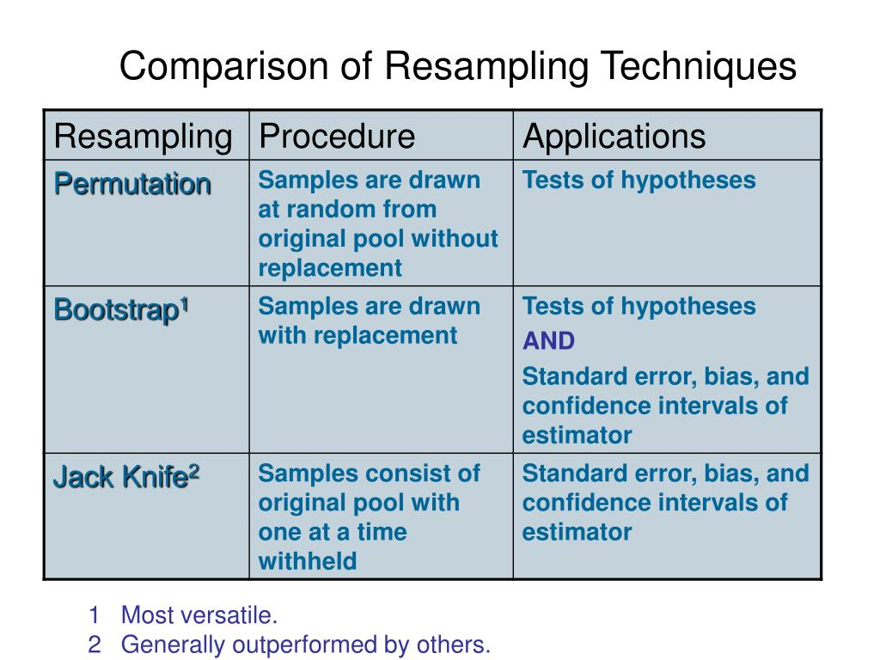
Bootstrapping versus Permutation

Slide 24
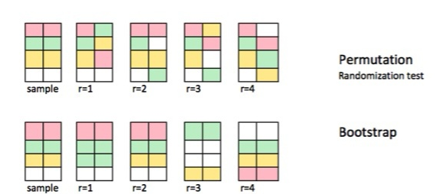
Bootstrapping versus Permutation

Slide 25
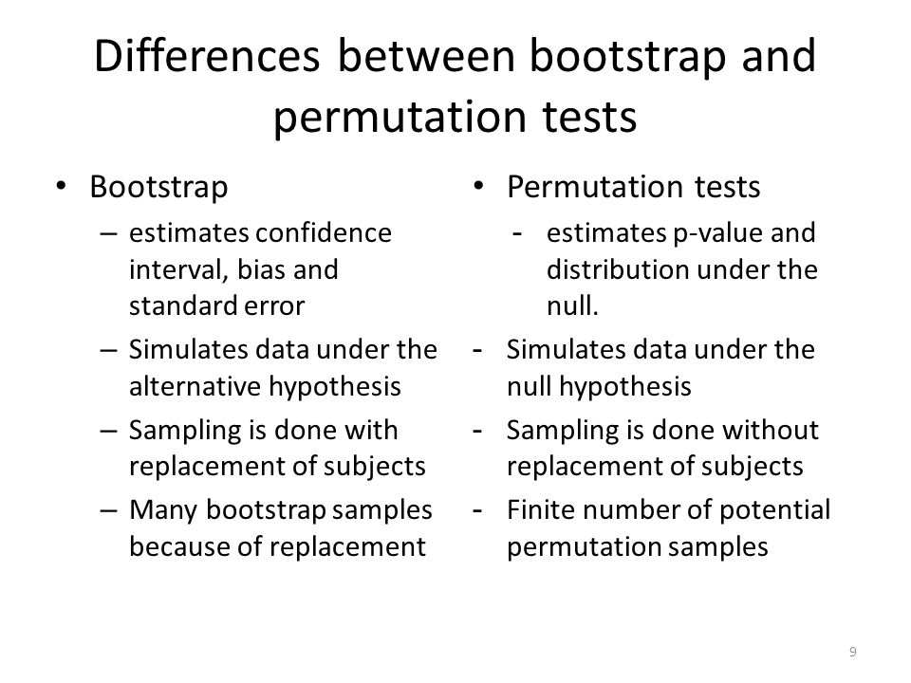
Bootstrapping versus Permutation

Slide 26
Code 9.7 Testing for phylogenetic signal

Slide 27
Phylo signal in the predictor (y = Xβ + ε, where ε ~ N(0, V) )
Caveat: pGLS methods assume phylogenetic structure in the response variable; I am unaware whether there are methods that can deal with phylogenetic signal in both the response AND predictor variables..

Slide 28
Code 9.8 Phylogenetic signal in the independent variable

Slide 29
Running the phylo regression model (y = Xβ + ε, where ε ~ N(0, V) )
Once you have established that there is phylogenetic signal or not, proceed to run analysis and check the fixed model component Xβ
The fixed model can be evaluated using t-tests, LRTs as before

Slide 30
Real world problems
Typically for the comparative method you will have the following before you start the analysis in R:
1. A spreadsheet of species with trait & environment data
2. A phylogeny of those species or a larger phylogeny that
you can cut down to your set of species
Steps of analysis:
A. read in both data files
B. reduce both data components to the minimum list of common species between dataframe and phylogeny
C. Check for phylogenetic signal
D. Run first gls() and select best model of fixed effects

Slide 31
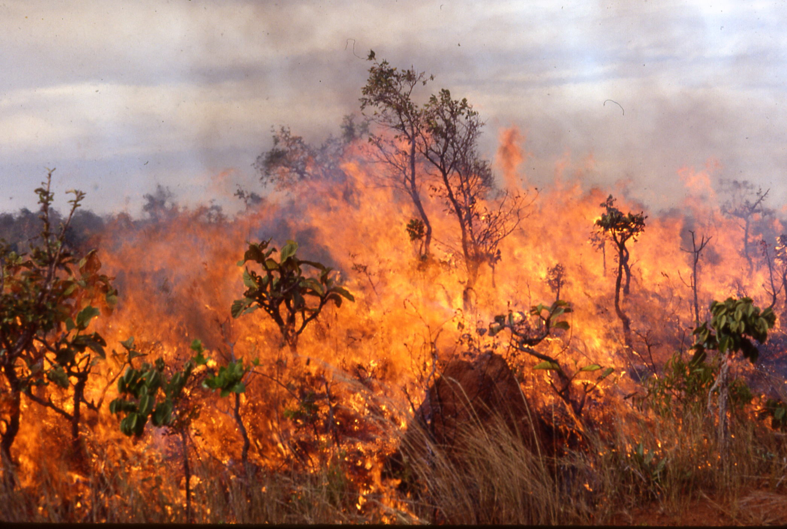
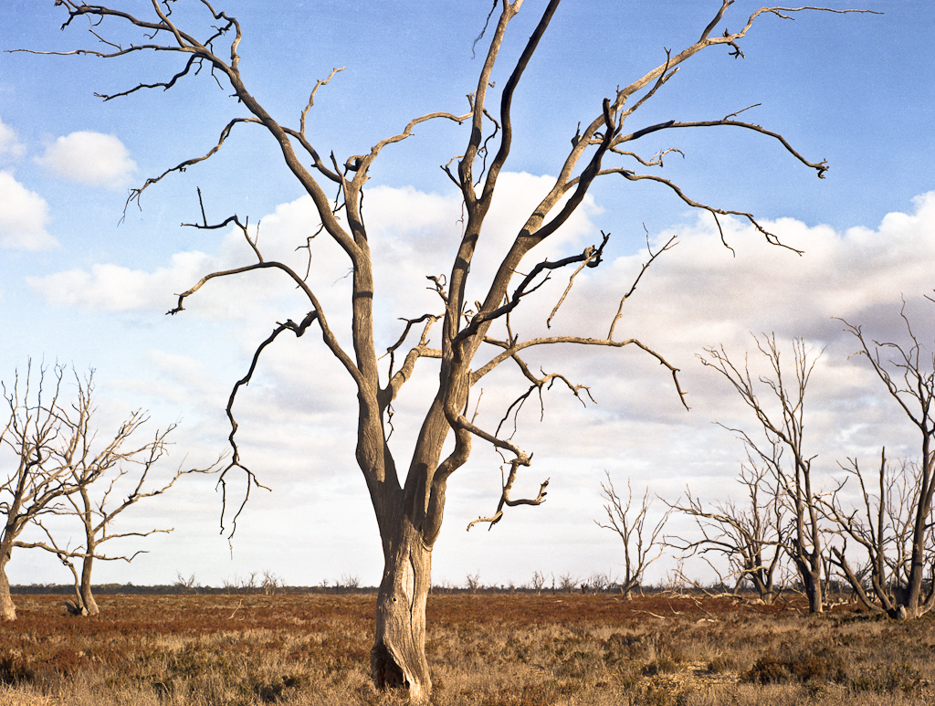
The savanna tree seedling dataset
Question: do traits of seedling trees of humid and semi-arid savannas differ?
Environment: humid savannas are subject to more frequent fire whereas semi-arid savannas are subject to more water stress

Slide 32
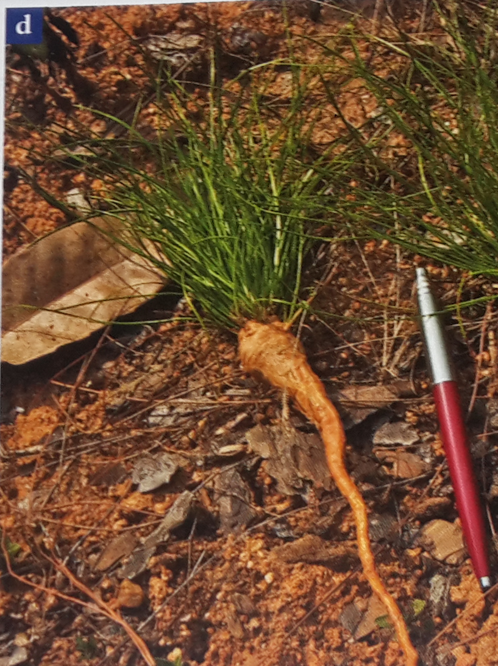
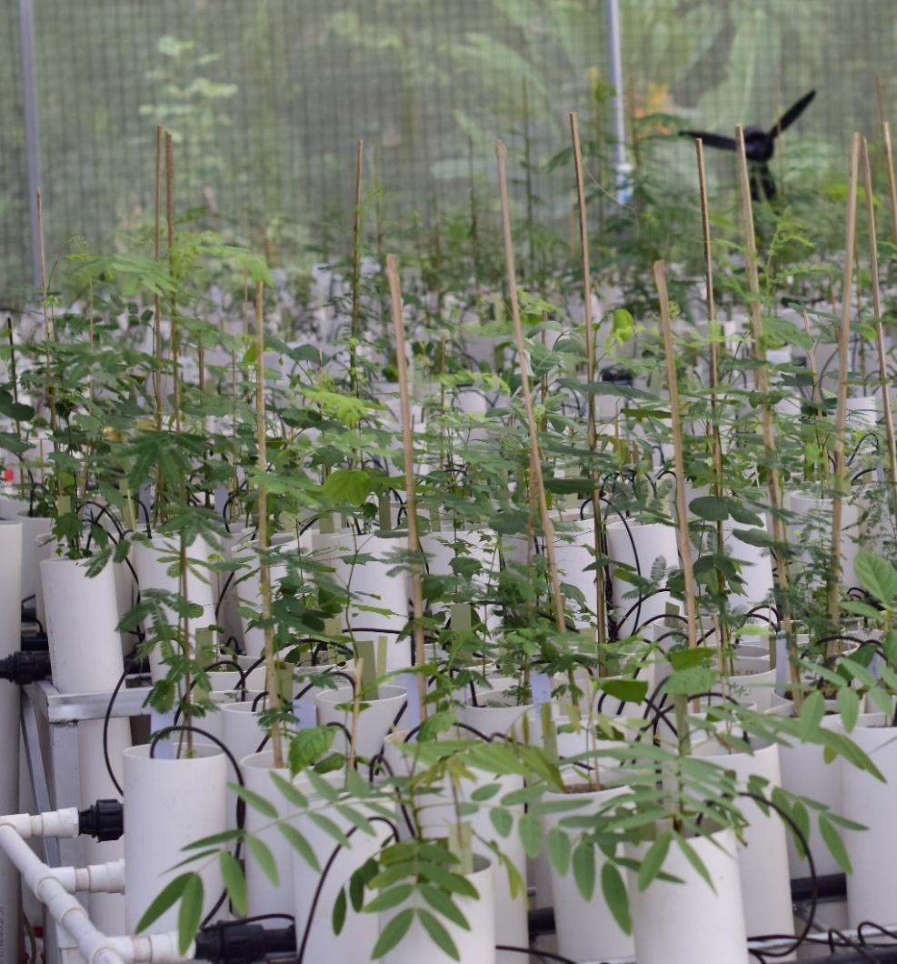
The savanna tree seedling dataset
Hypotheses:
H1: Tree seedlings in fire-prone systems allocate more biomass root storage -> ⬆ root mass fractions.
H2: Tree seedlings in water-stressed environments access deeper water -> ⬆ root extension rate.
Experiment: Common garden
Tree species from humid and
semi-arid savannas on 3 continents.
Grown for 20 weeks.
Many traits measured.
© Peter Ashton

Slide 33
Code 9.9 The savanna tree seedling dataset H1: RMF is greater among humid species

Slide 34
Exercise 9.1
Test hypothesis 2
H2: Tree seedlings in water-stressed environments access deeper water -> ⬆ root extension rate.
(the variable is RER in mm day⁻¹)

